Slide 1
UNIT V

Slide 2
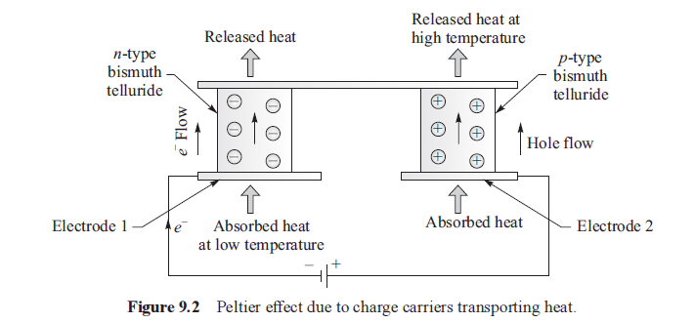
PELTIER EFFECT:

Slide 3
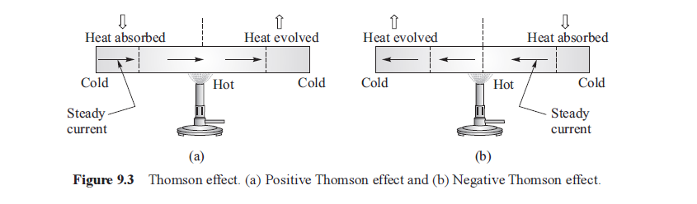
THOMSON EFFECT:

Slide 4
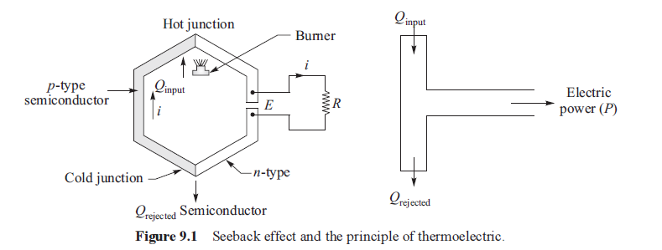
SEEBACK EFFECT:

Slide 5
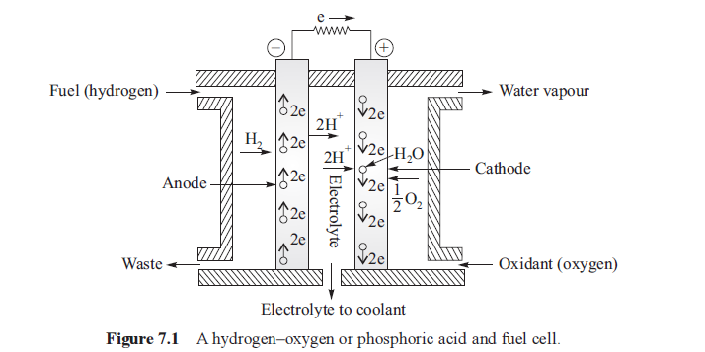
FUEL CELL:

Slide 6
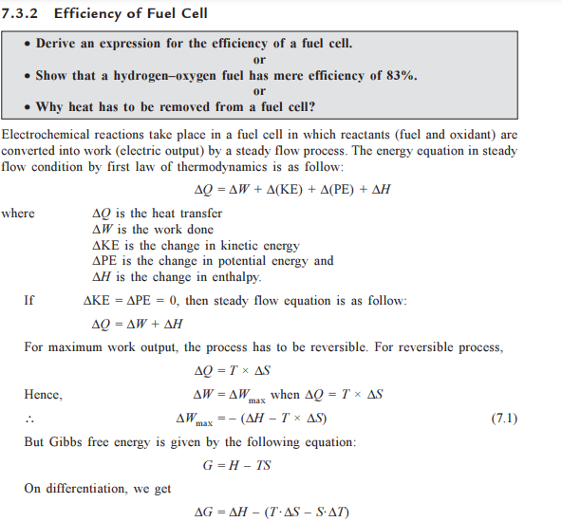

Slide 7
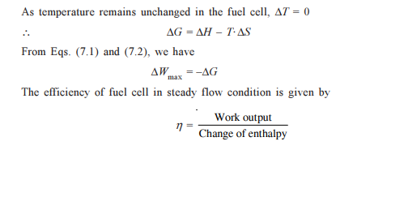

Slide 8
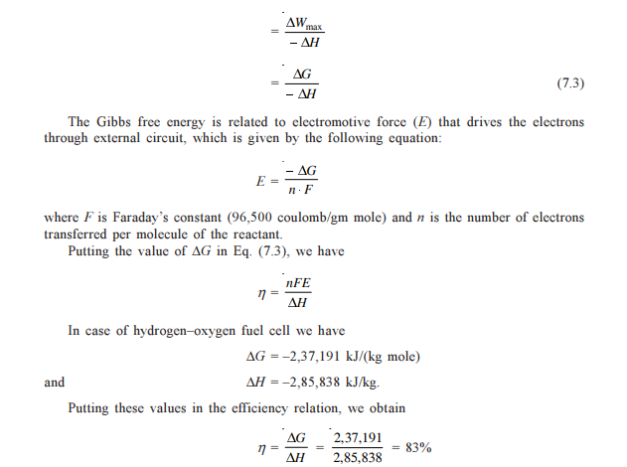

Slide 9

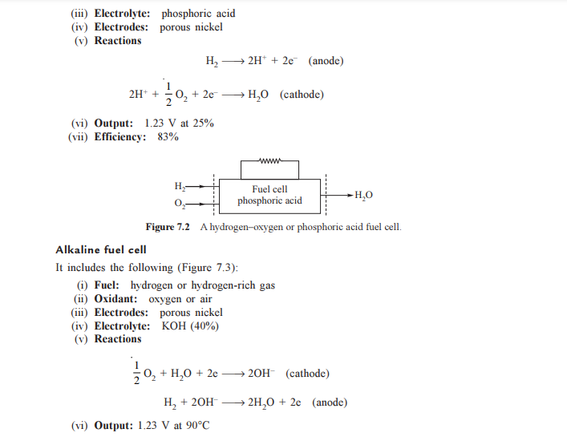

Slide 10
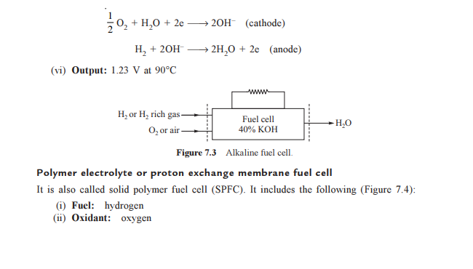

Slide 11
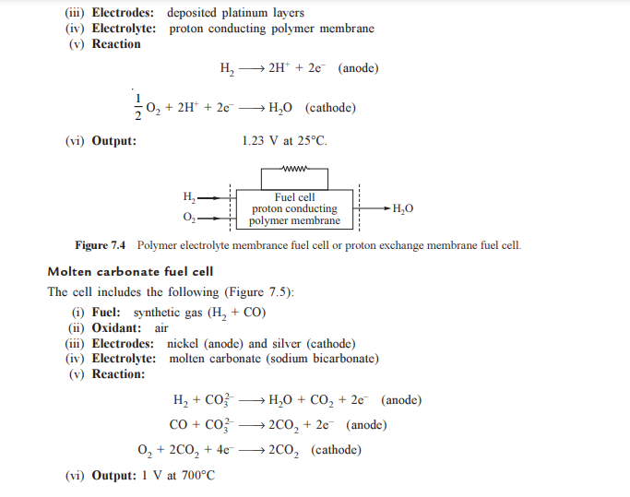

Slide 12
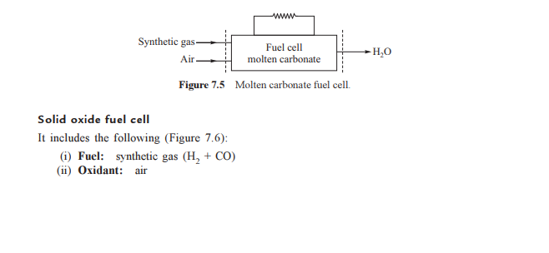
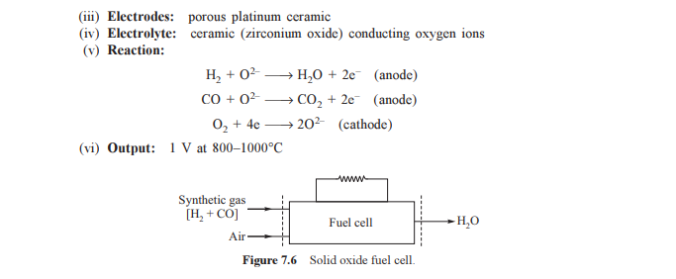

Slide 13
Regenerative fuel cell: Types →Polymer electrolyte membrane fuel cell →Alkaline fuel cell →Molten carbonate fuel cell →Solid oxide or ceramics fuel cell

Slide 14
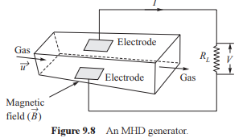
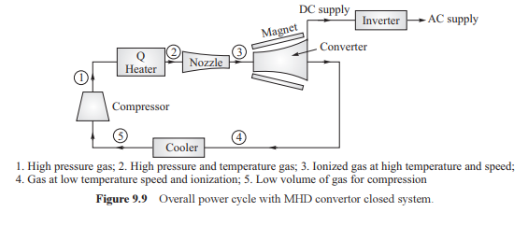
MHD Generation system:

Slide 15
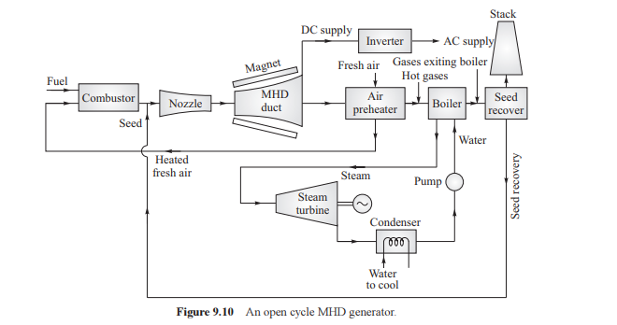
Open Cycle MHD System:

Slide 16
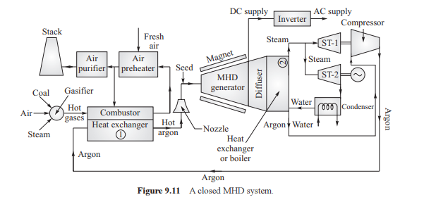
Closed Cycle MHD System:

